Slide 1
Breaking the Black Box of Data Analysis
December 5, 2018
Presenters
Paul St. Roseman
Roberto Flores

Slide 2
Questions
How do we make data analysis and inclusive and engaging experience?

Slide 3
Who we are
Data Use Consulting Group (DCG) is a firm that specializes in collaborative program evaluation research.

Slide 4
Who we are
DCG works with mid-size education and human service organizations to develop custom solutions that design, implement, and sustain cost effective internal program evaluation studies.

Slide 5
Who we are
DCG guiding principal is:
Your data… your decisions

Slide 6
The Model
Design
Collect
Analyze
Use

Slide 7
The Challenge
Design
Collect
Analyze
Use
Data analysis is a black box experience
for DCG clients that needs to be disrupted.

Slide 8

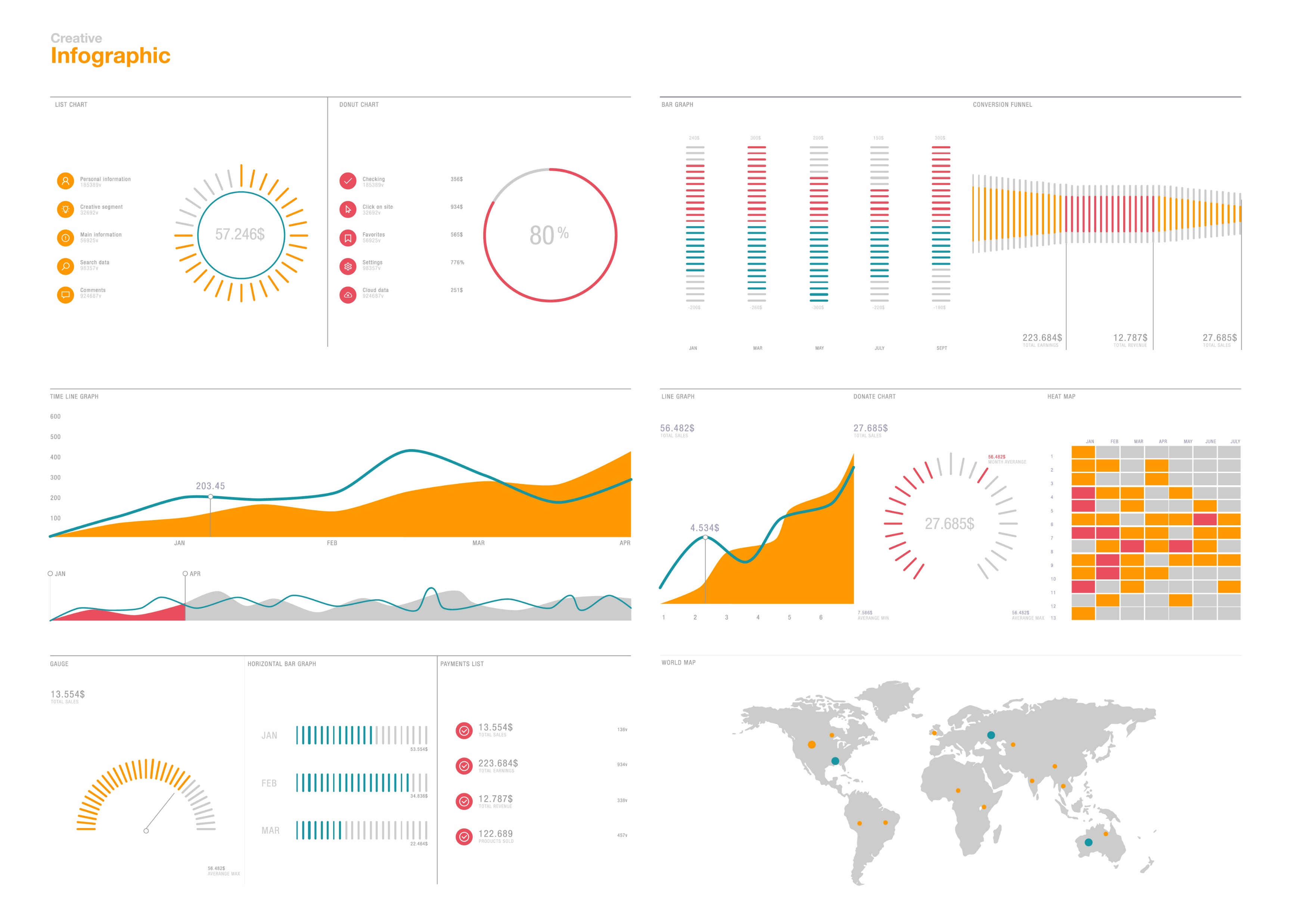
The Challenge
Analyze
Use
Static Reports and PowerPoints
Interactive Visualizations

Slide 9
Project
Task 1
Merge academic assessment, social emotional learning, and cultural climate data tables into one interactive visualization for a local Bay Area Charter school.

Slide 10
Project
Task 2
Use machine learning to identify relationship between data variables.

Slide 11



Project
Step 1
Wrangle data using Python and a Jupyter Notebook
Step 2
Create data visualization using Excel
Step 3
Test relationships between variables using machine learning

Slide 12
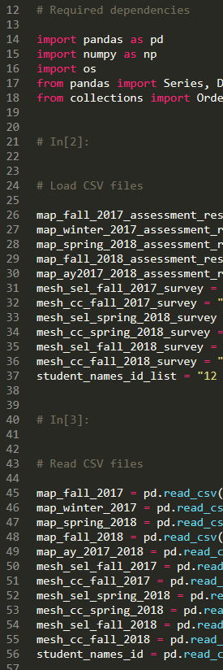
Content from 13 CV files were merged.
The total data set included 1,991 rows of with over 300 variables.
The final transformed data set included 641 rows and 200 variables
Step 1
Data Wrangling

Slide 13
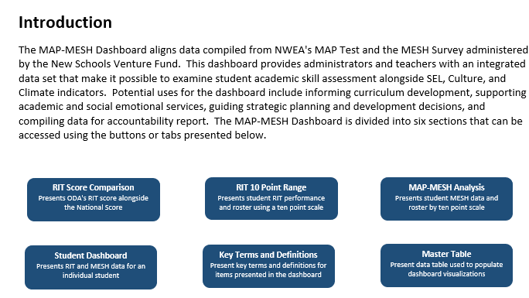
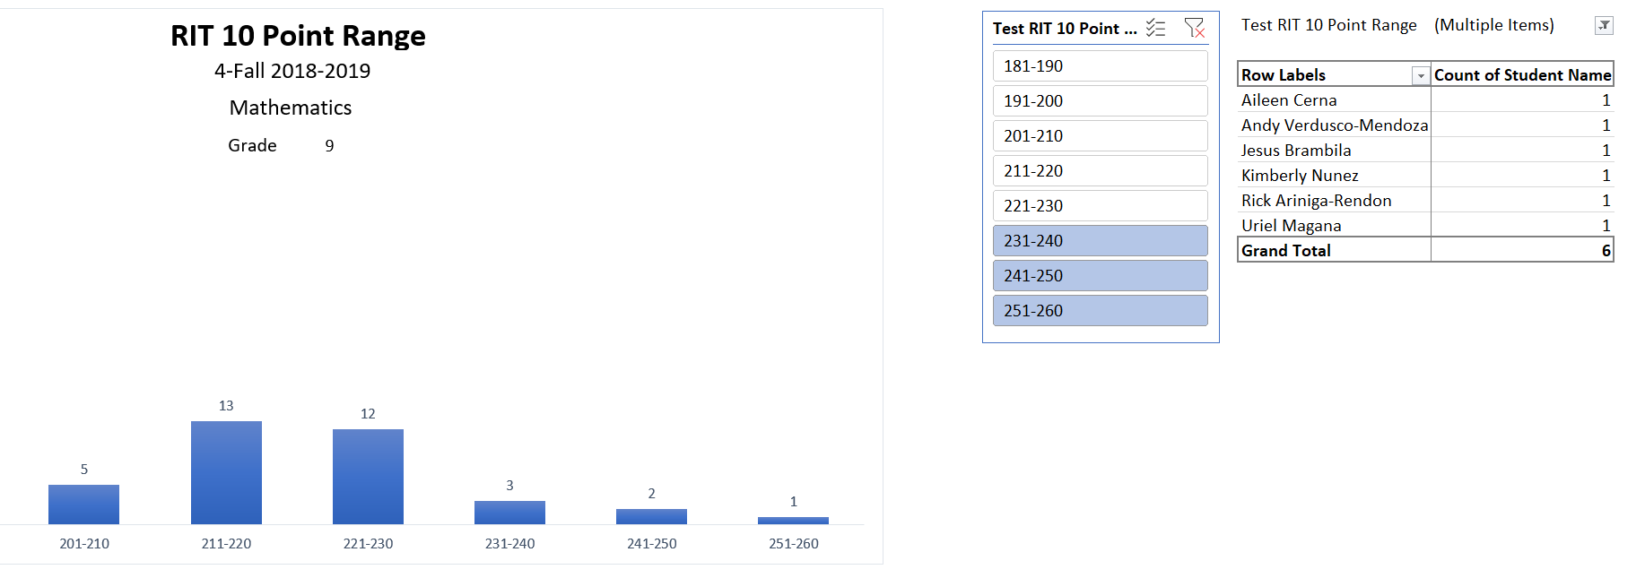
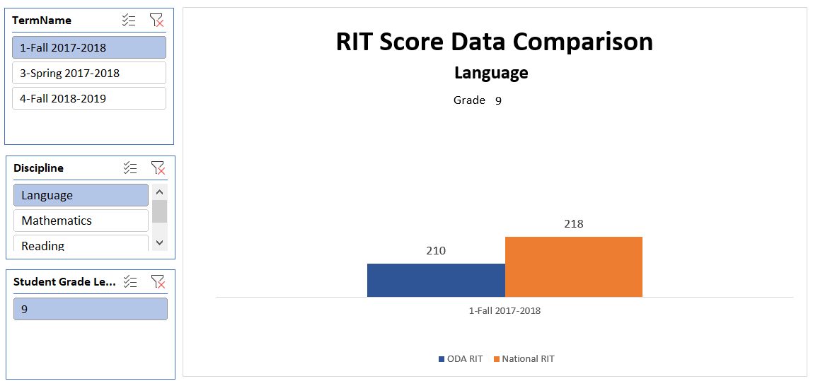
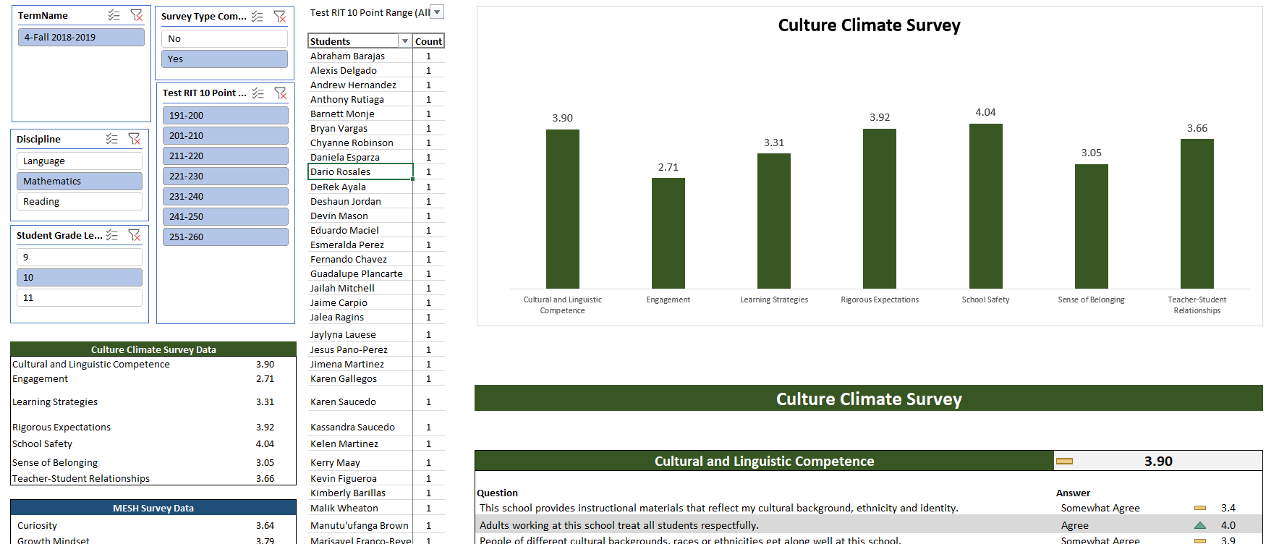
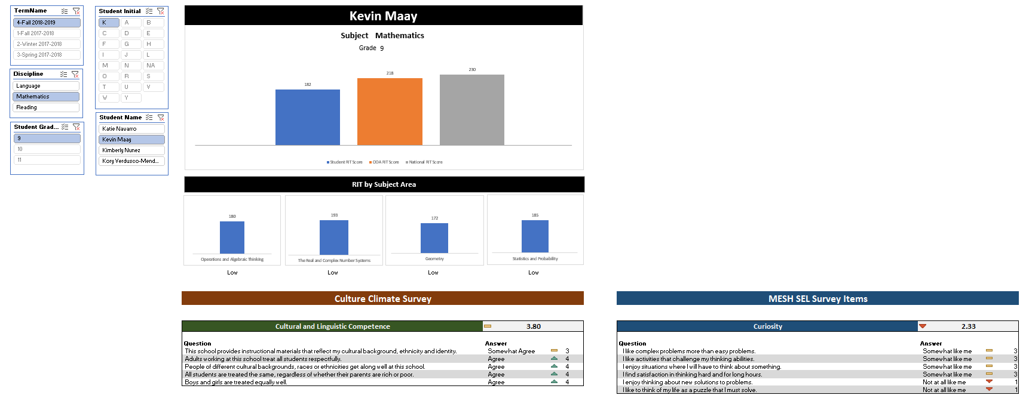
Step 2
Data Visualization

Slide 14
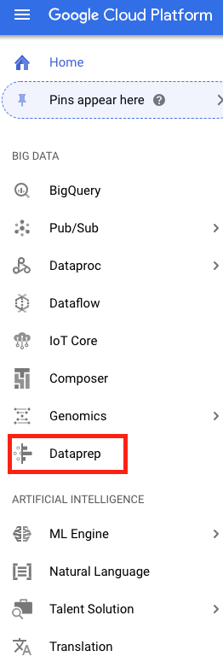
Machine Learning Regression Analysis
Step 3
Machine Learning
Focus: Data Munging and Deciding (y) Dependent Variable and (x) Independent variable
Used Google Cloud Platform [GCP]
Used Dataprep service to support data munging and high level Data correlation

Slide 15
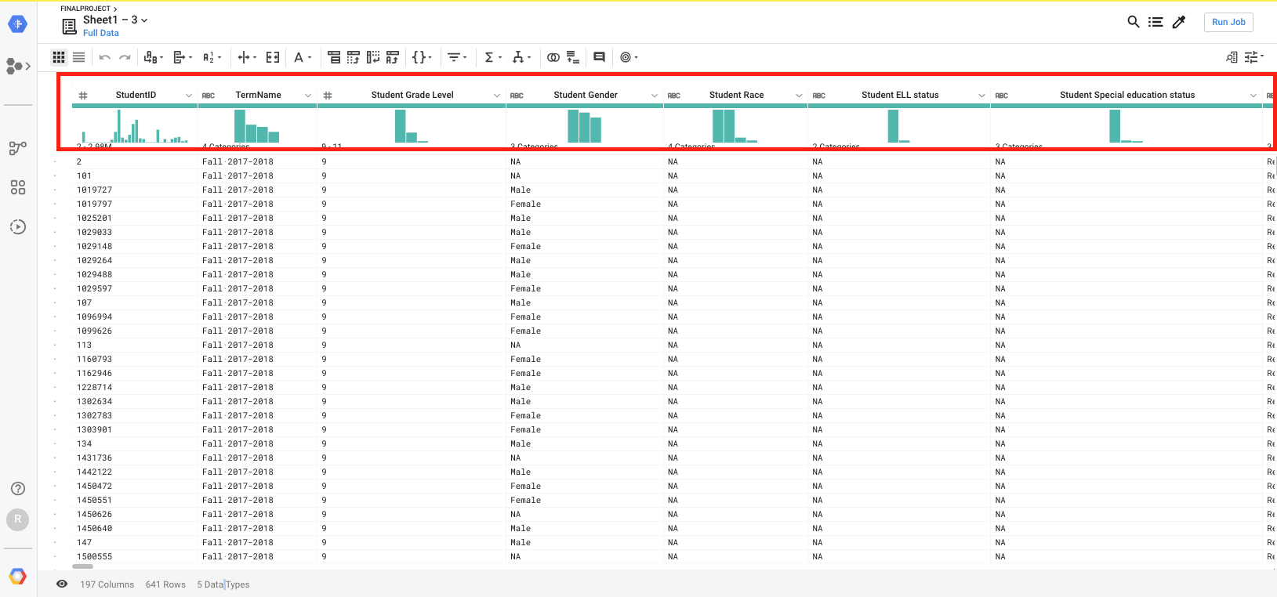
Data Prep
Drafting Hypothesis
Step 3
Machine Learning

Slide 16
Hypothesis & Testing Variables
Step 3
Machine Learning
Preliminary Finding: Students who take more time to complete the MAP test have lower RIT scores
Analysis 1:Test Growth Mindset Survey Questions [X Variable] Against Scores [Y Variable]
Analysis 2: Test Growth Mindset Average Scores [X Variable] Against Test Scores [Y Variable]

Slide 17
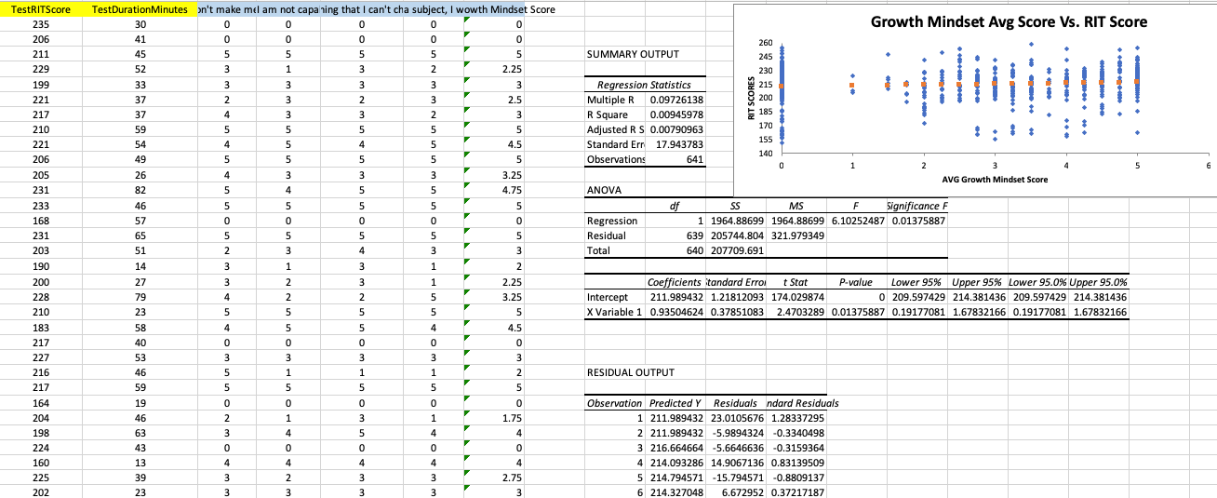
Model Predictions
Step 3
Machine Learning

Slide 18
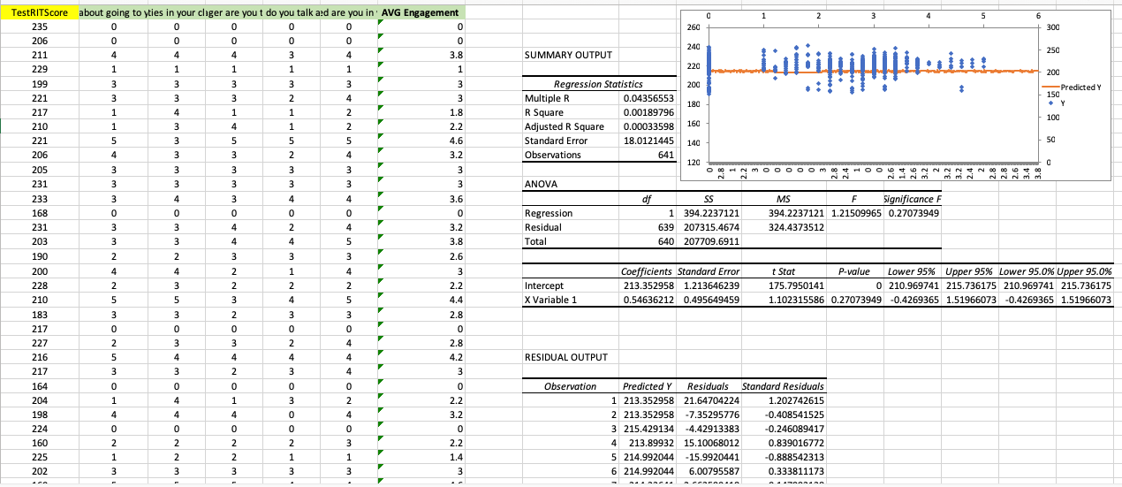
Engagement Vs. RIT Scores
Step 3
Machine Learning

